Slide 1
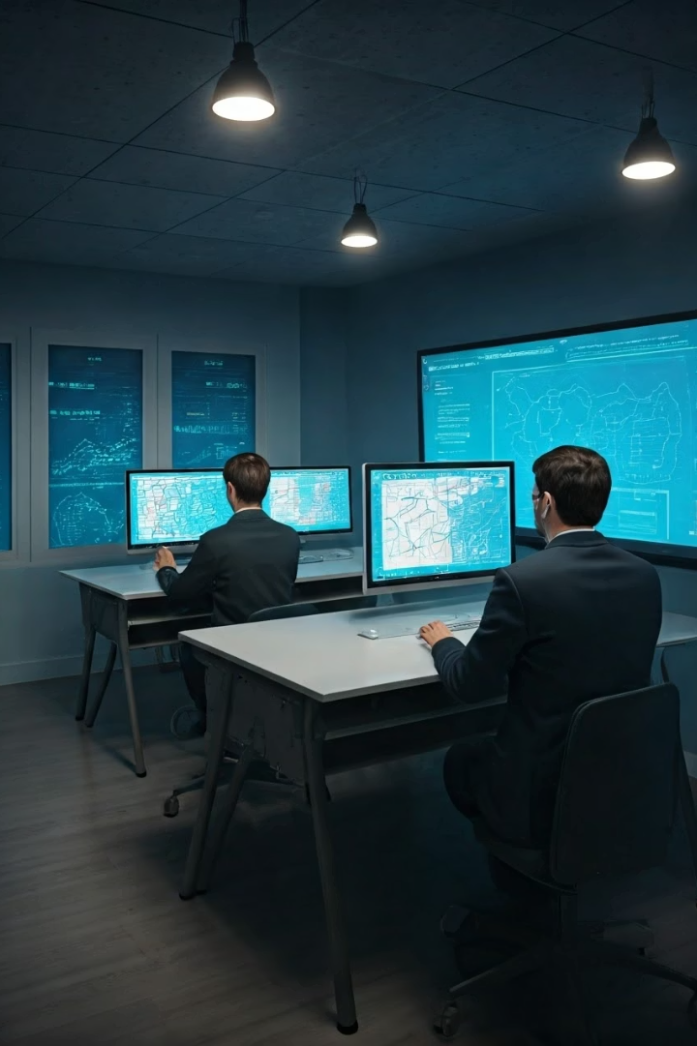

Face Recognition and Attendance System Using OpenCV and Python
This presentation explores an innovative system combining OpenCV and Python for facial recognition attendance. We’ll discuss its background, challenges, implementation, and outcomes. This solution enhances accuracy and efficiency in attendance management.
Made By Sarthak Sharma
&
Sahil Chalotra
&
Damnjeet Singh

Slide 2
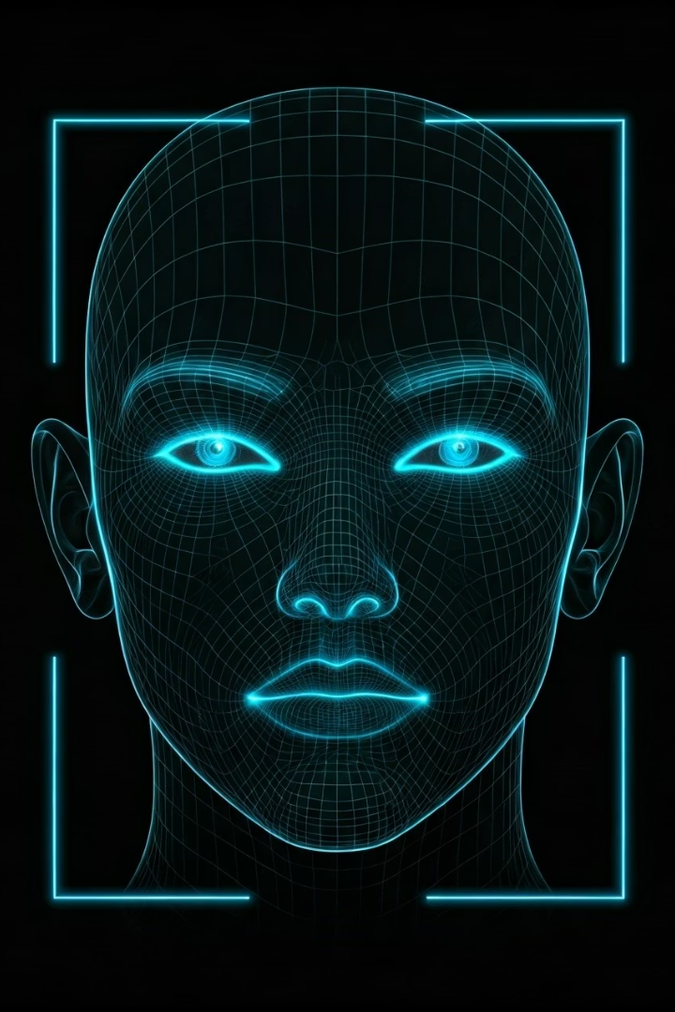
Introduction to Face Recognition Systems
What is Face Recognition?
Importance in Attendance
A biometric method using unique facial features to identify individuals.
Speeds up process, reduces fraud, and automates record keeping.
Role of OpenCV & Python
OpenCV offers powerful image processing; Python enables easy integration.

Slide 3
Background: History and Technology
Early Development
OpenCV and Python
Face recognition started in the 1960s using manual measurements.
OpenCV released in 2000, widely adopted for computer vision.
Modern technology uses machine learning and neural networks.
Python simplifies coding and supports real-time applications seamlessly.

Slide 4

Problem Statement: Existing Challenges
Manual Attendance Issues
Technical Challenges
Time-consuming and error-prone
Accurate face detection in varied lighting
Susceptible to proxy attendance
Low frame rate cameras can reduce accuracy

Slide 5
Case Analysis: Use Case in Educational Institutions
Scenario Overview
Benefits Observed
Automated attendance during daily lectures using facial recognition cameras.
Reduced attendance time from minutes to seconds
Accurate records eliminate proxy attendance
System matches live faces with stored profiles efficiently.

Slide 6

Solutions and Implementation
Development Setup:
OpenCV integrated with Python for image capture and processing.
Face Detection:
Used HOG-based face detection via the face_recognition library.
Face Recognition:
Use Deep learning-based face encoding via the face_recognition for
High accuracy.
Attendance Logging:
Automated marking attendance by appending recognized names with timestamps to a CSV file.

Slide 7
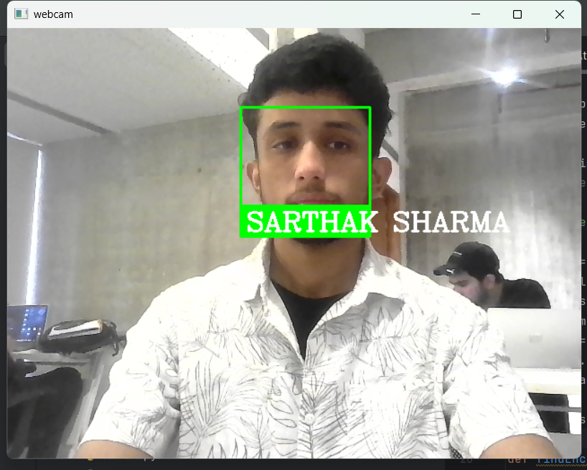
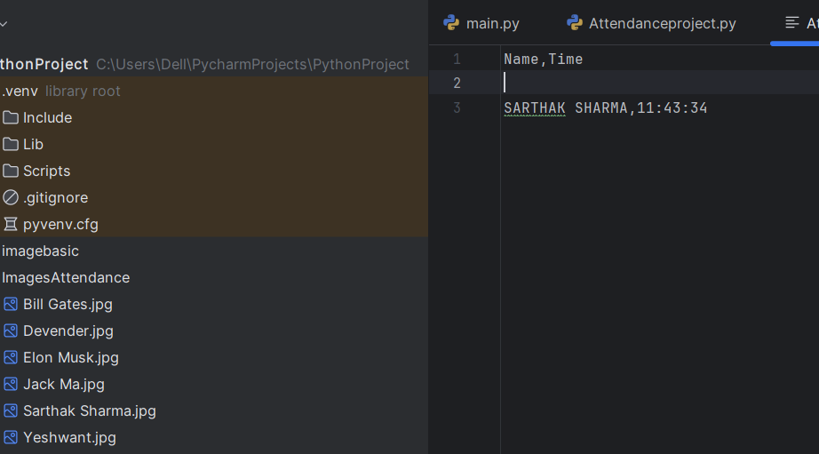
Results and Outcomes
Improved Accuracy
Attendance errors reduced drastically compared to manual methods.
User Acceptance
Positive feedback from teachers and students for ease of use.
Time Efficiency
Attendance taken in seconds, improving classroom productivity.

Slide 8





Next Steps and Future Work
Expand Dataset
Collect diverse face data for better recognition accuracy.
Integrate AI Models
Use deep learning for improved face detection and recognition.
Mobile App Development
Create mobile attendance apps with face recognition features.
Continuous Feedback
Incorporate user feedback to enhance system usability.

Slide 9
Conclusions and Recommendations
Conclusions
Recommendations
Face recognition system streamlines attendance, reduces errors.
Expand system with multi-angle cameras for increased accuracy.
OpenCV and Python offer accessible tools for real-time solutions.
Integrate with school management software for seamless data flow.
Regularly update face databases for new students and staff.

Slide 10

References and Resources
Core Libraries
Face Recognition Algorithms
Development Tutorials
OpenCV official documentation: https://opencv.org/
Python face recognition tutorials and real-time application guides.
HOG,Deep Learning,ML approaches overview.

Slide 11
THANK YOU
THANK YOU

